Slide 1
Welcome To Presentation On
Photo Stock Management System

Slide 2
Photo Stock Management System
I’m student of Delta Computer Science College in Computer Science and Engineering. This project supervised by Jagadish Chandra Ray. Assistant Professor, Department of CSE , Delta Computer Science College, Rangpur.
Group Member :
Name : Shoumitro Ray
Registration No : 15502000130
Name : M.Billah
Registration No : 15502000118

Slide 3
Index
Introduction
Objective
List of Activity
List of diagram
Use Case Diagram
Sequence diagram
Collaboration Diagram
State Chart Diagram
Activity Diagram for Client
Component Diagram
Deployment Diagram
0-Level & 1st Level Admin Side DFD
1st Level – Client Side DFD
E-R Diagram

Slide 4
Index-2
Interface design
Client Side Interface
Admin Side Interface
Device Support
Limitation
Future plan
Conclusion

Slide 5
Introduction
The prime objective of this project to buy image using internet and to save time, to save money. it will be used for image stock management Company. It is very helpful to manage image in gallery and selling images. All clients must be an account to buy images. So, It has login and registration method for every client and consist of banking transaction system for payment. It is develop by the language HTML5, CSS3, JSP, MySQL database and JavaScript.
Go to index

Slide 6
Objective
To save time, to save money.
To help clients that can want to buy image.
It is create an environment to buy and sell images.
It also manage all employee in this system.
It has an gallery for sell image using internet.
Go to index

Slide 7
List of activity
Login activity
Registration activity
Profile activity
Home activity
Account activity
Contact activity
Buy activity
Pricing activity
Search activity
Order activity
Go to index

Slide 8
List Of Diagram
Data Flow Diagram
Component Diagram
Deployment Diagram
E-R Diagram
Use Case Diagram
Sequence Diagram
Collaboration Diagram
State Chart Diagram / State Machine Diagram
Activity Diagram
Go to index

Slide 9
Use Case Diagram for Client

Slide 10
Use Case Diagram for Gallery

Slide 11
Use Case Diagram for Checkout

Slide 12
Sequence Diagram

Slide 13
Collaboration Diagram for Client

Slide 14
State Chart Diagram for Client

Slide 15
Activity Diagram for Client

Slide 16
Component Diagram

Slide 17
Deployment Diagram

Slide 18
0-Level & 1st Level Admin Side DFD

Slide 19
1st Level – Client Side DFD

Slide 20
E-R Diagram (part 1)

Slide 21
E-R Diagram (part 2)

Slide 22
E-R Diagram (part 3)

Slide 23
E-R Diagram (part 4)

Slide 24
E-R Diagram (part 5)

Slide 25
Interface Design
This interface divided into two part.
1. Client Side interface
2. Admin Side interface

Slide 26
Client Side Interface
This user interface design for visitor or client or customer.

Slide 27
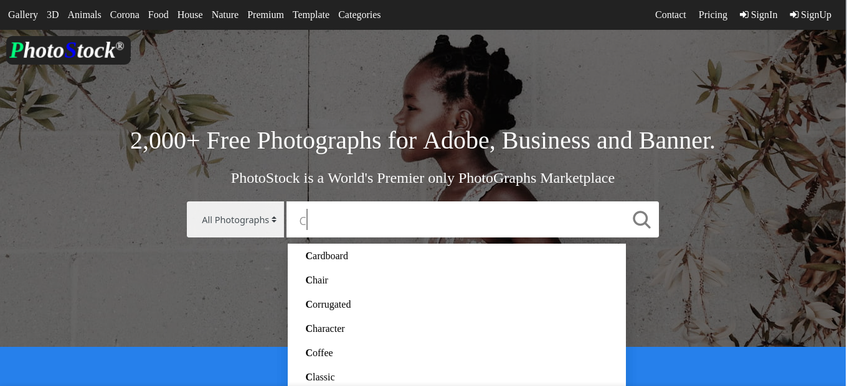
Home page

Slide 28
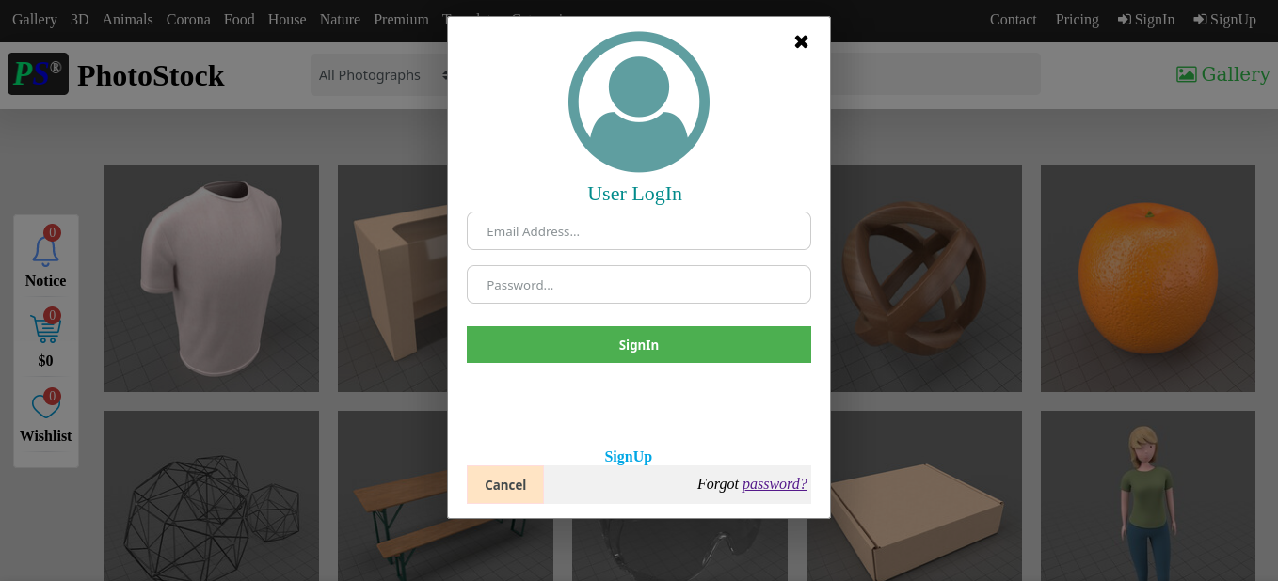
Login Page

Slide 29
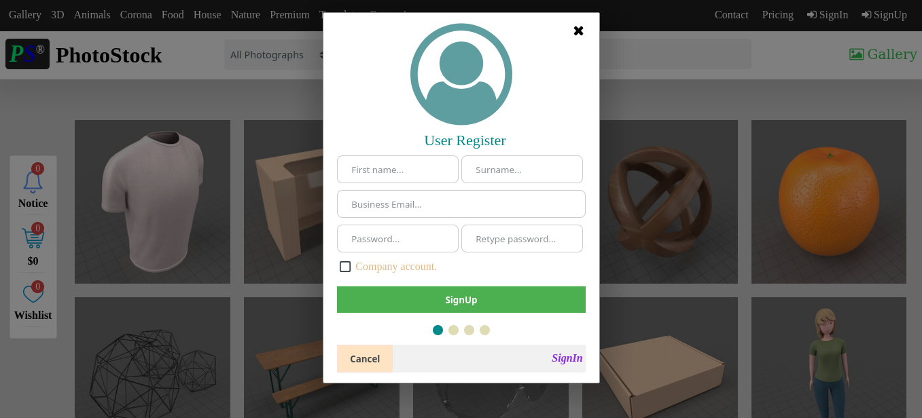
Registration

Slide 30
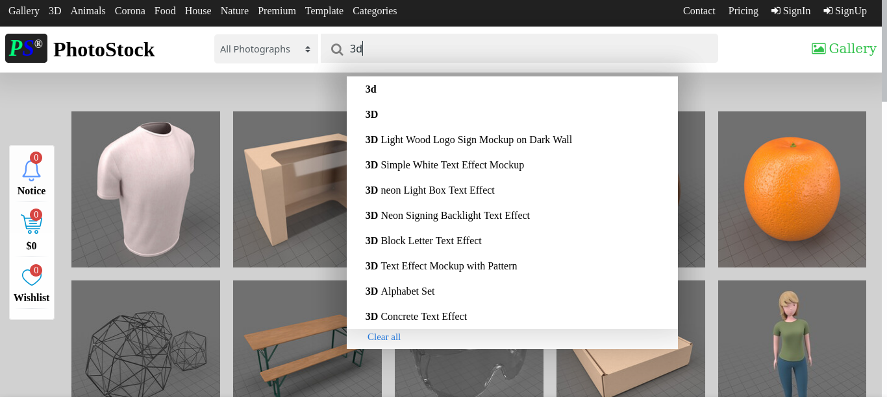
Gallery

Slide 31
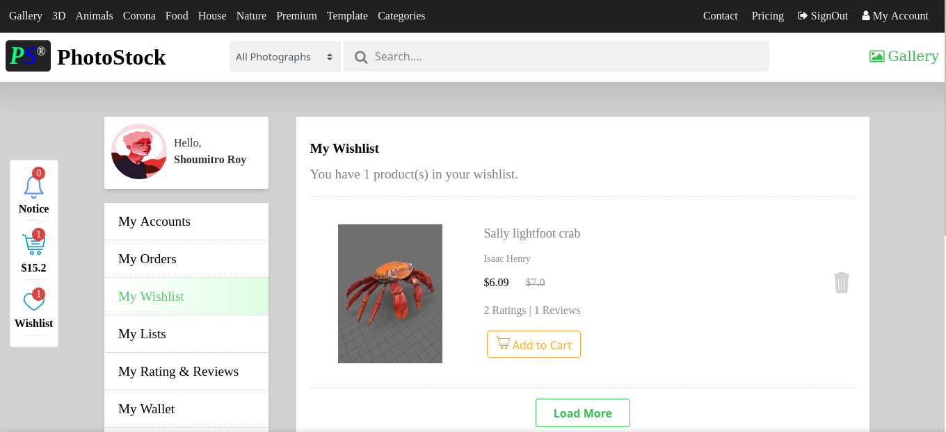
Wish List

Slide 32
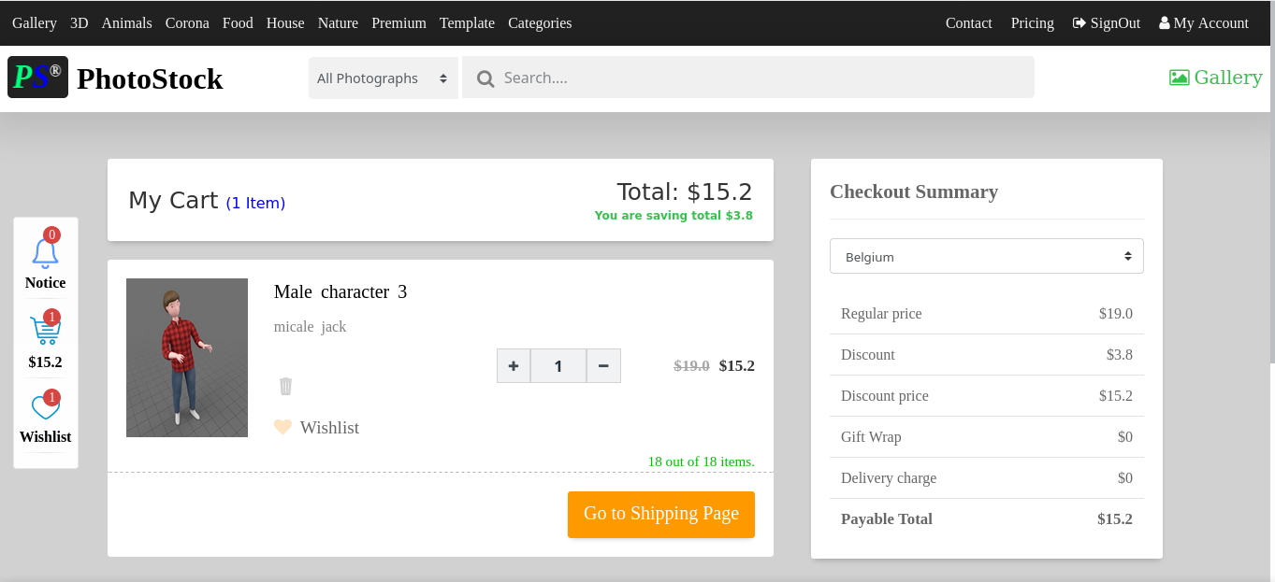
Add To Cart

Slide 33
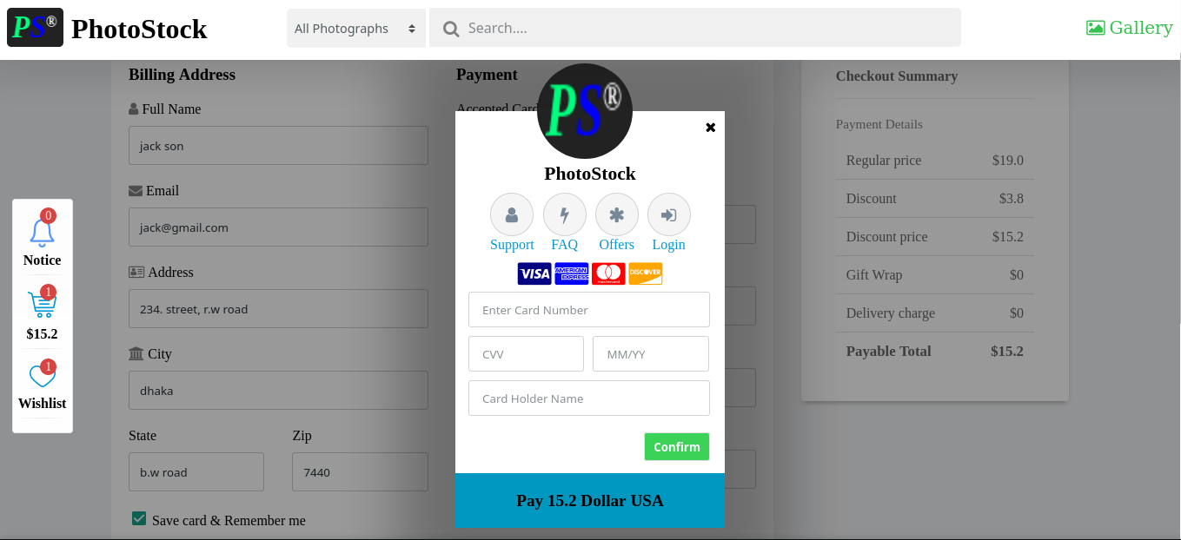
Payment

Slide 34
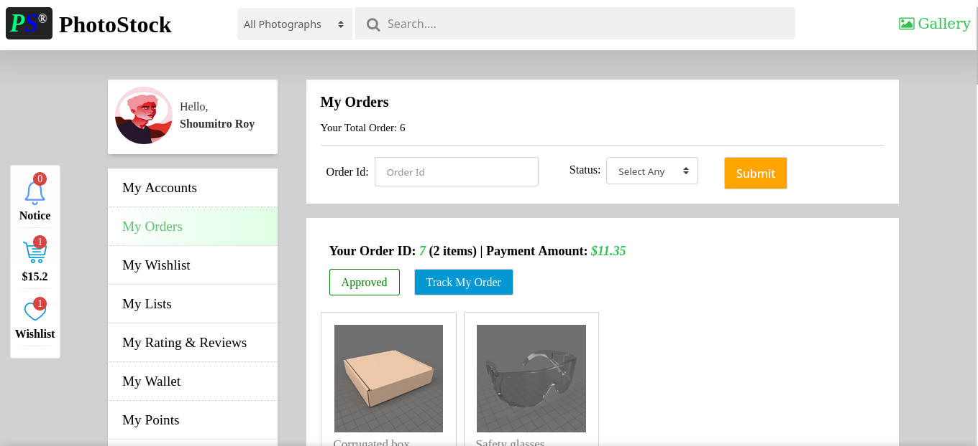
Order

Slide 35
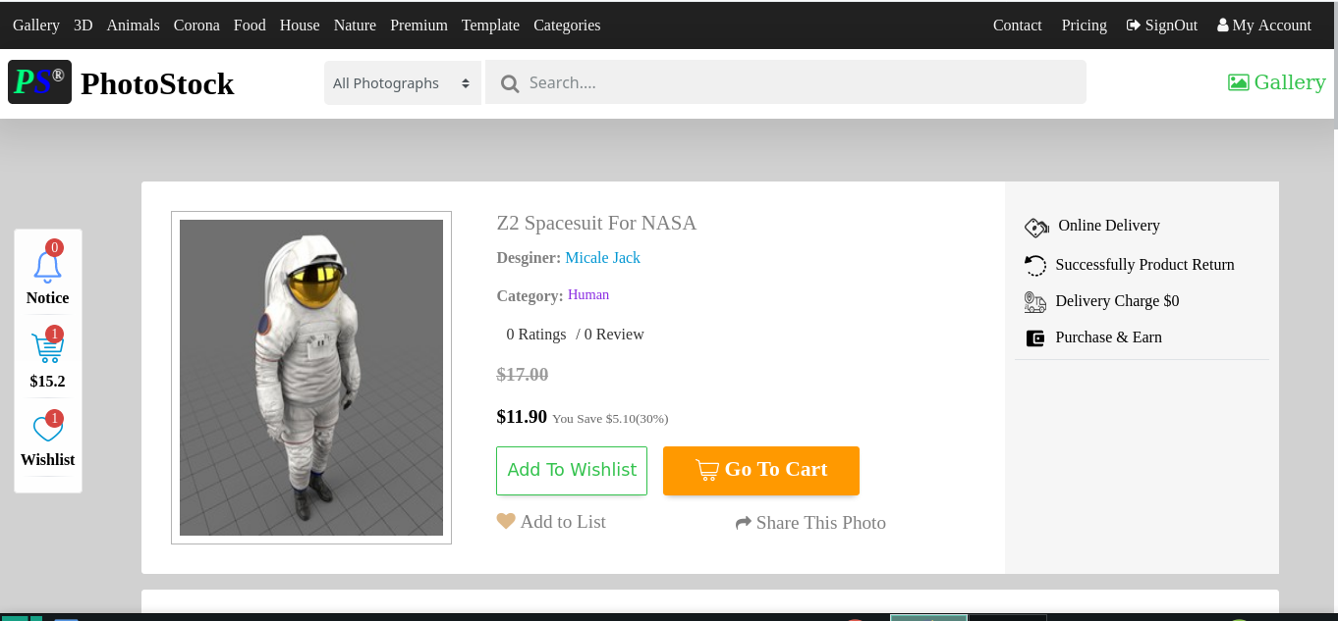
Product

Slide 36
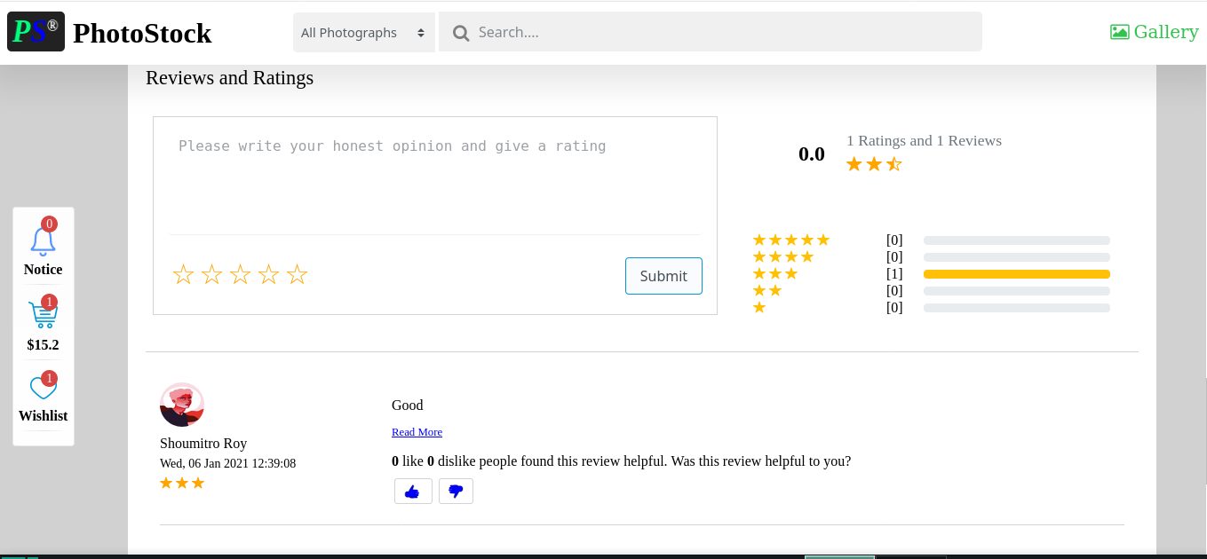
Rating and Review

Slide 37
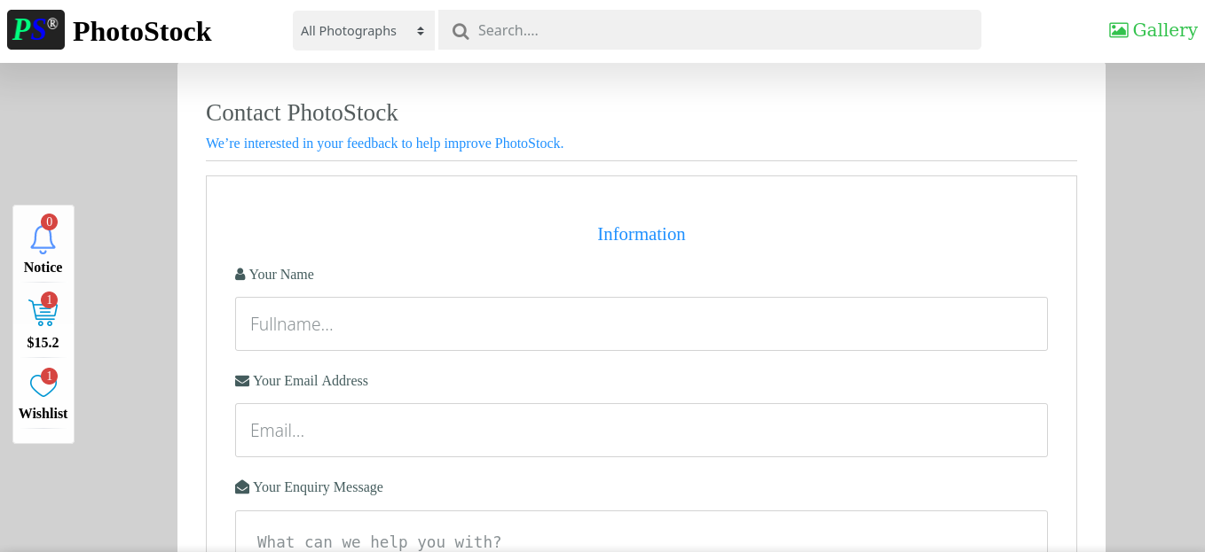
Contact

Slide 38
Admin Side Interface
This interface only design for admin.

Slide 39
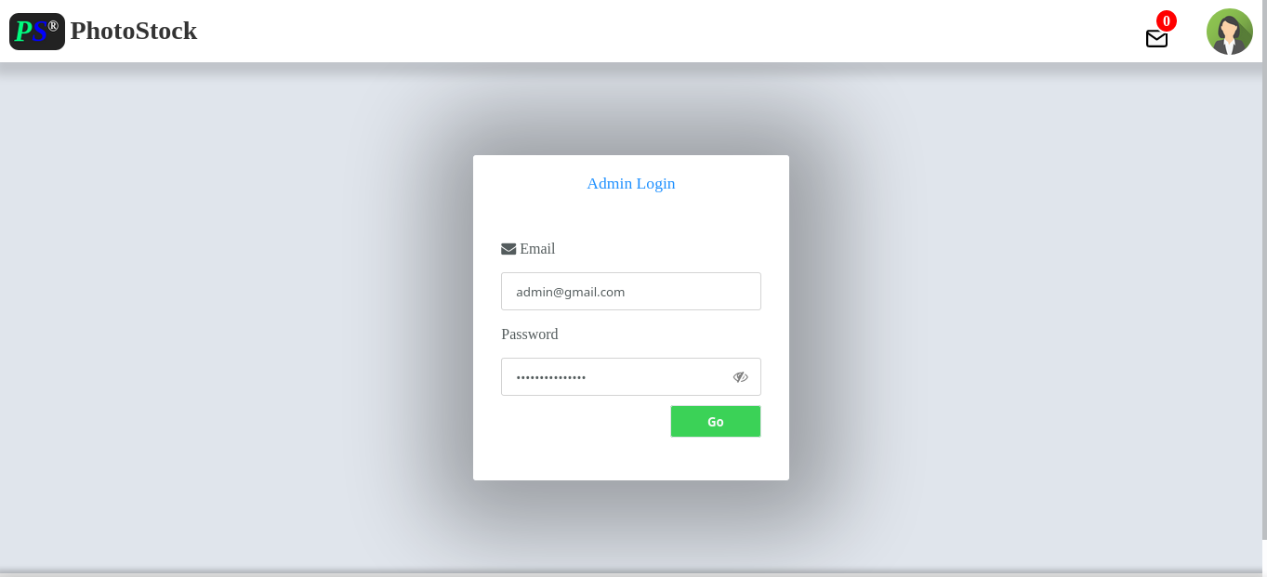
Admin Login

Slide 40
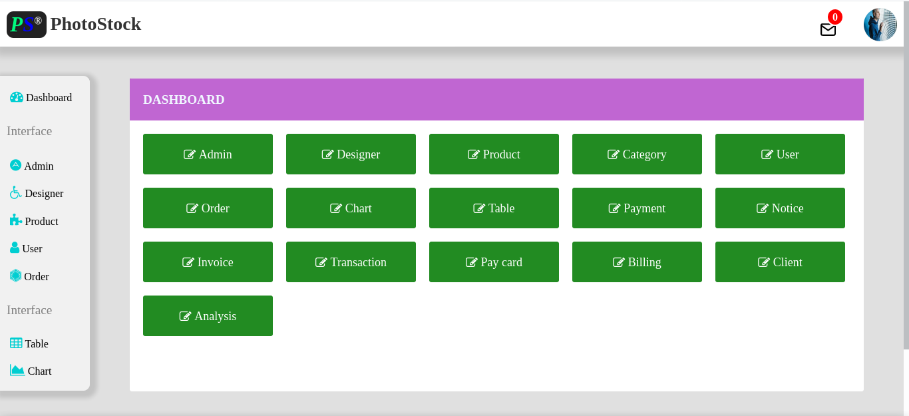
Dashboard

Slide 41
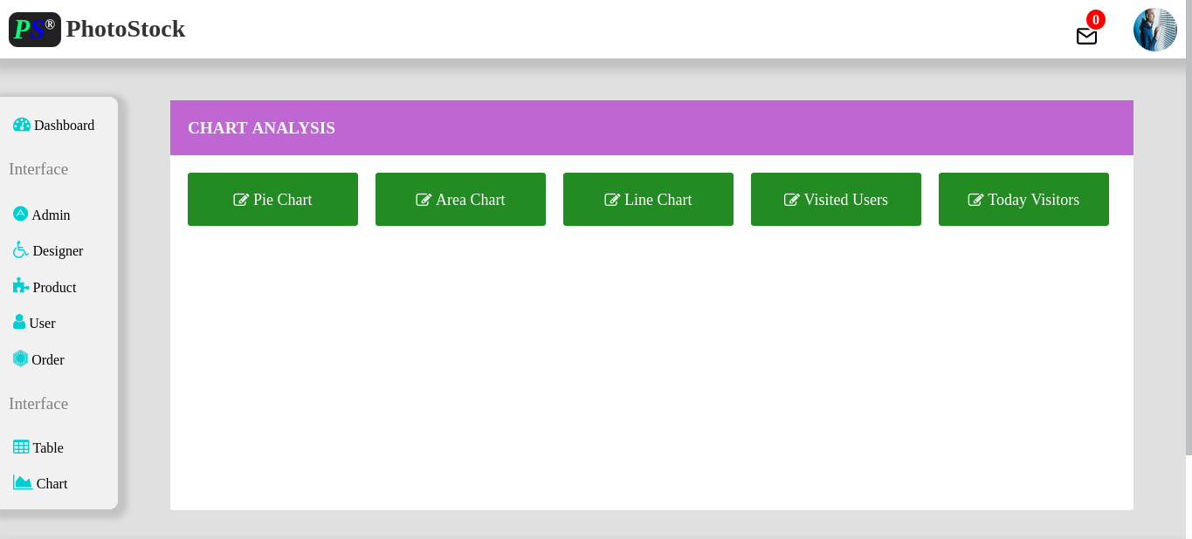
Chart Analysis

Slide 42
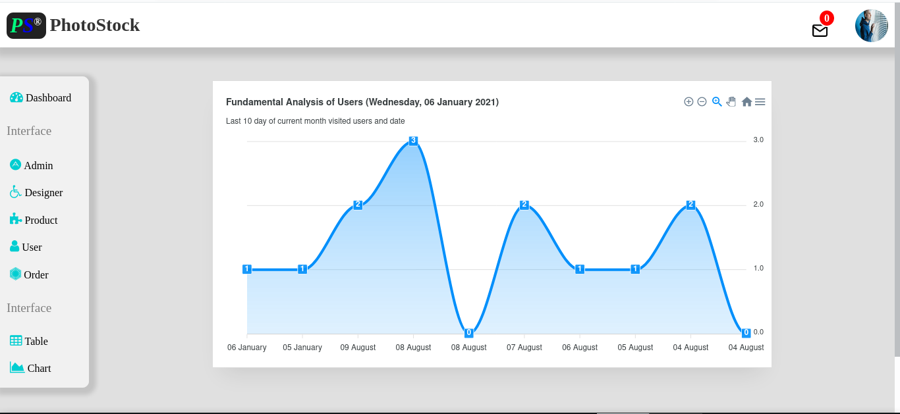
Area Chart

Slide 43
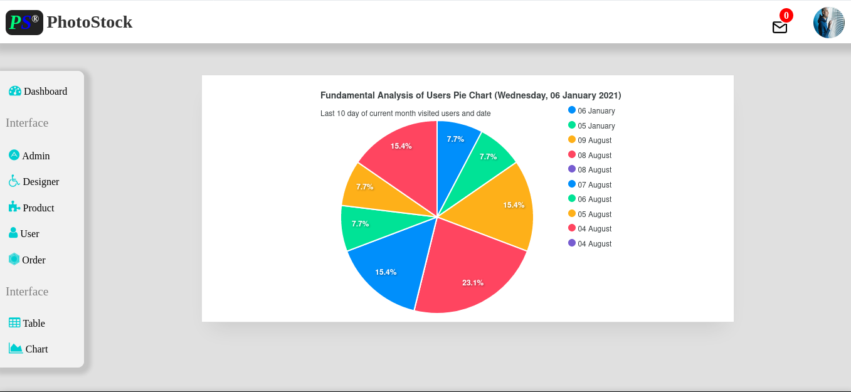
Pie Chart

Slide 44
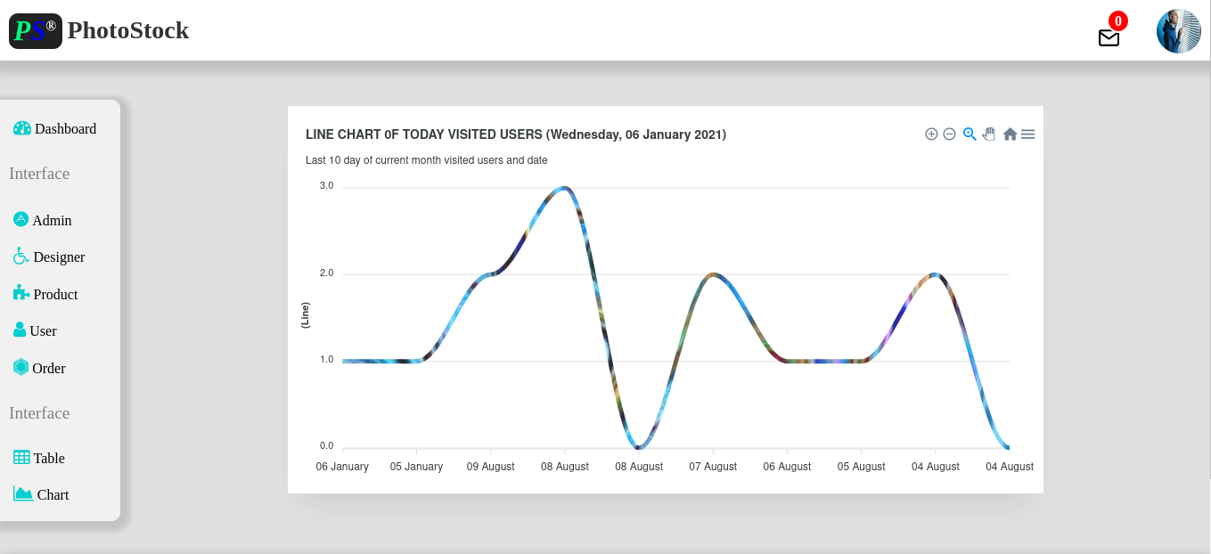
Line Chart

Slide 45
Device Support
This project support tablet and smart phone.

Slide 46
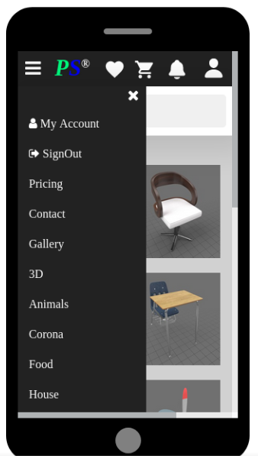
Smart Phone

Slide 47
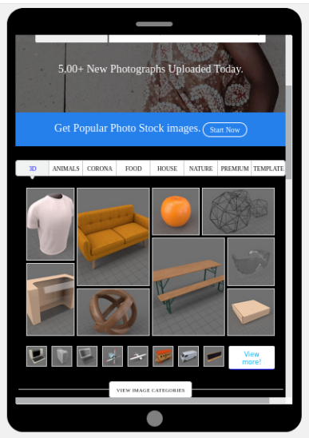
Tablet

Slide 48
Limitation
This project contained some limitation. it can not use real time transaction payment system. also it can't show some interface like rating and review analysis, list view, purchased points. All the design of this project is very simple. here, it has not use different security tool which increase protection a system. it is only use some core technology like javascript, jsp, ajax and simple design database.

Slide 49
Future Plan
The following things can be done in future.
The users could subscribe for price alerts which would enable them to receive messages when price for products fall below a particular level.
The current system is confined only to the shopping cart process. It can be extended to have an easy to use check out process.
Users can have multiple shipping and billing information saved. During checkout they can use the drag and drop feature to select shipping and billing information.

Slide 50
Conclusion
The ‘Photo Stock Management System’ is designed to provide a web base service application that would make searching, viewing and selection of a product easier. The search engine provides an easy and convenient way to search for products where a user can Search for a product interactively and the search engine would refine the products available based on the user’s input. The user can then view the complete specification of each product. They can also view the product reviews and also write their own reviews.

Slide 51
Thanks
Happy Ending the Presentation

